Slide 1

Reverse Vending Machine
Elaborate by :
“ Vegeta”
Montassar Thabti
Wissal Bayoudh
Fedi Bayoudh
Moez Abid
Sarah Abidli
Mohamed Iheb Bousnina
College year 2019-2020

Slide 2
Plan
01
Project Context
02
Business objectives
03
Data Collection & Preparation
04
Modeling
05
Deployment
2

Slide 3
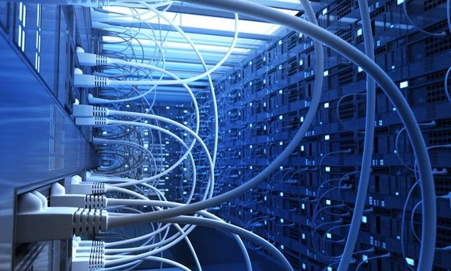


Introduction
Problematic
Project Context
Methodology
3
Notes:
Oddo bhf main goal is to be connected to their customers and able to provide them with the best financial decisions and that by managing its data and incorporate it into its business and professional practices. Our main mission in this project is to help Oddo make those decisions by presenting prediction values for its customers by analyzing and interpreting the provided data in order to help it reach better decisions.

Slide 4
Introduction[1/3]
~Problematic~
So the main task of this machine is to capture the waste and the classifier according to their types : Plastic, glass…
In order to respond to the problem of waste management, an idea of creating an intelligent trash was made.
The main problem was the lack of sorting, which means that the waste is either burned or piled up in a landfill,
This project offers a credible and hopeful solution to today’s sustainable development goals.
Sorting waste and recycling it are crucial issues of our century
4

Slide 5
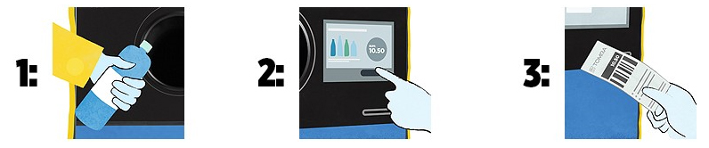
Introduction[2/3]
~Project Context~
Step1:
Step2:
Step3:
Put a plastic bottle or can in the machine
Detect the bottle if it is acceptable
Give a reward to the customer
5

Slide 6
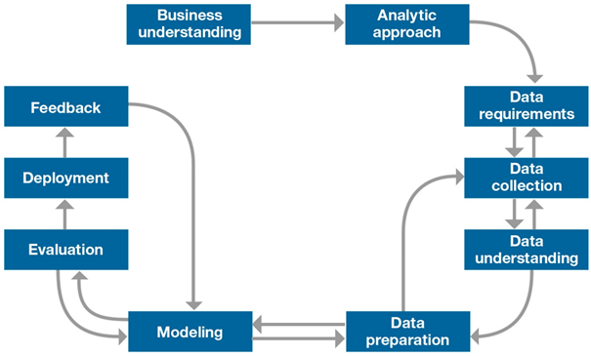
Introduction[3/3]
~ IBM MASTER PLAN METHODOLOGY ~
6

Slide 7
Business
Objectives
7
Notes:
Oddo bhf main goal is to be connected to their customers and able to provide them with the best financial decisions and that by managing its data and incorporate it into its business and professional practices. Our main mission in this project is to help Oddo make those decisions by presenting prediction values for its customers by analyzing and interpreting the provided data in order to help it reach better decisions.

Slide 8
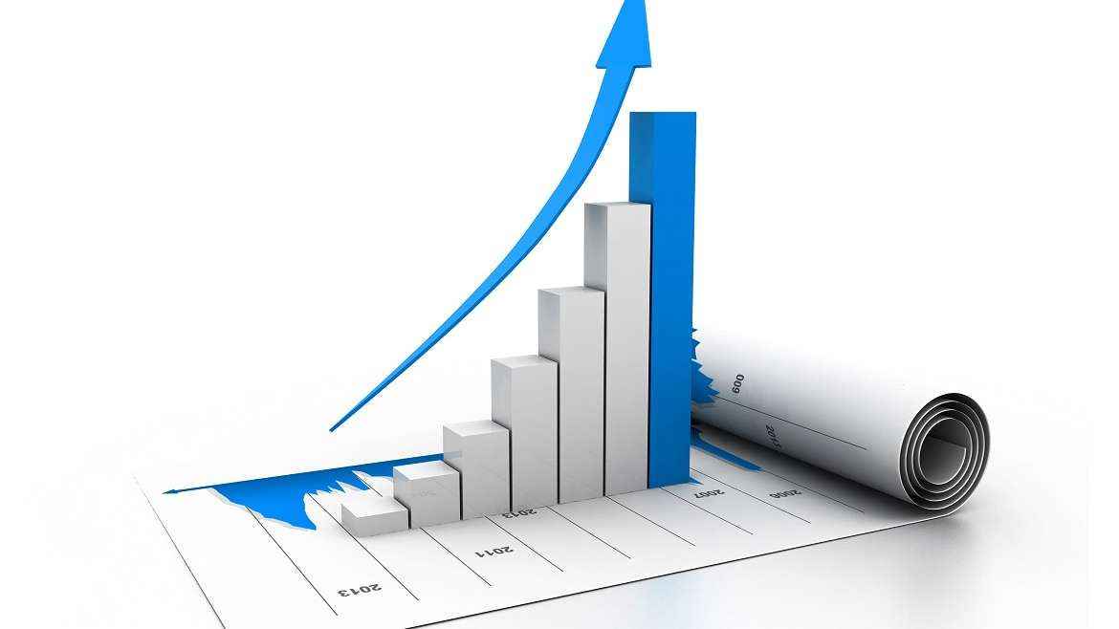
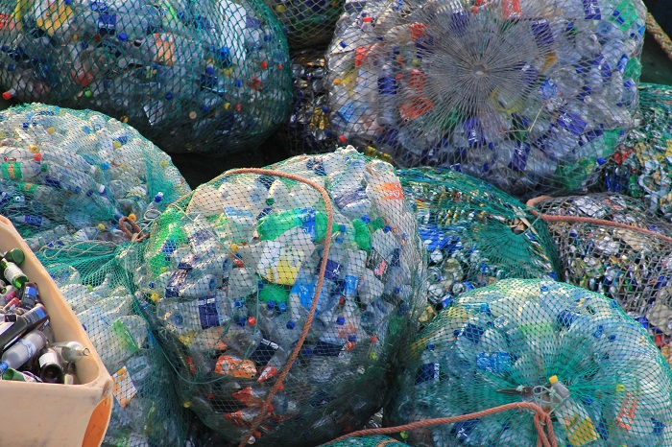
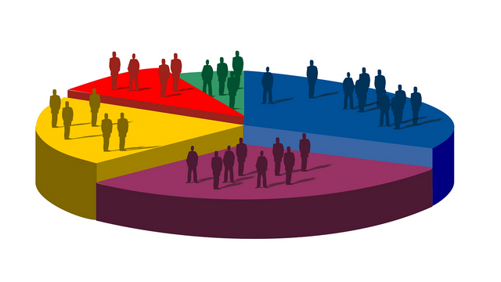
Business Objectives[1/2]
8

Slide 9

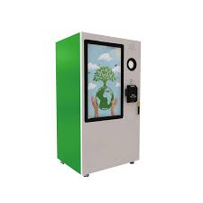

Business Objectives[2/2]
9

Slide 10
Data collection
& Preparation
Internal Data
External Data
10
Notes:
Oddo bhf main goal is to be connected to their customers and able to provide them with the best financial decisions and that by managing its data and incorporate it into its business and professional practices. Our main mission in this project is to help Oddo make those decisions by presenting prediction values for its customers by analyzing and interpreting the provided data in order to help it reach better decisions.

Slide 11
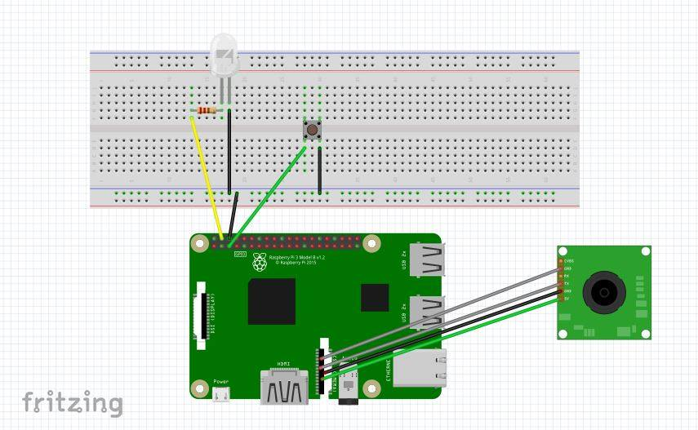
Internal Data [1/3]
(FRITZING ➔ Equipment connection )
11

Slide 12
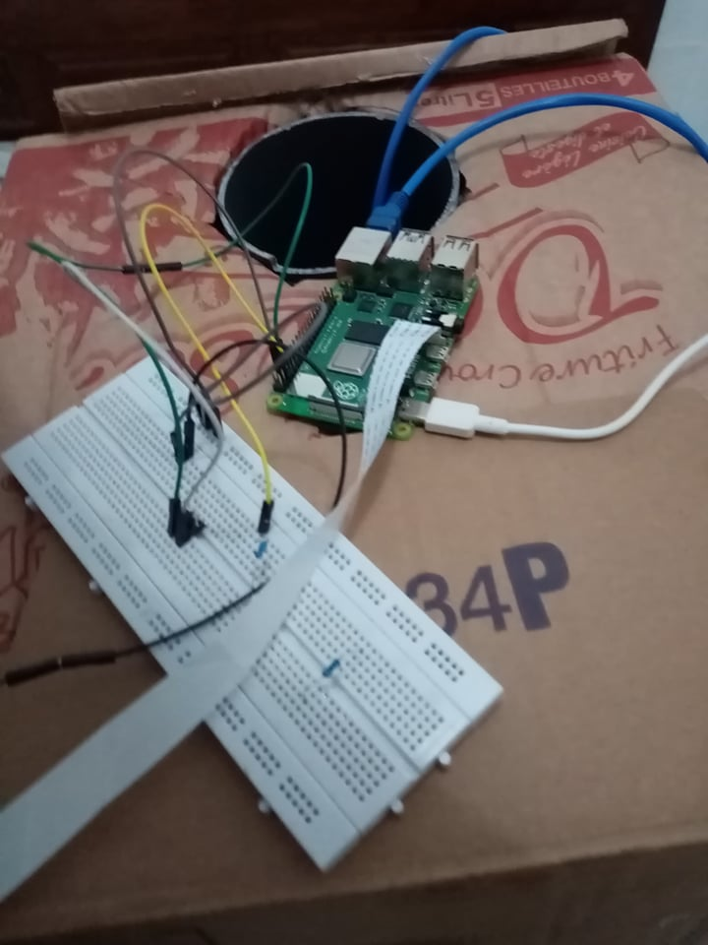
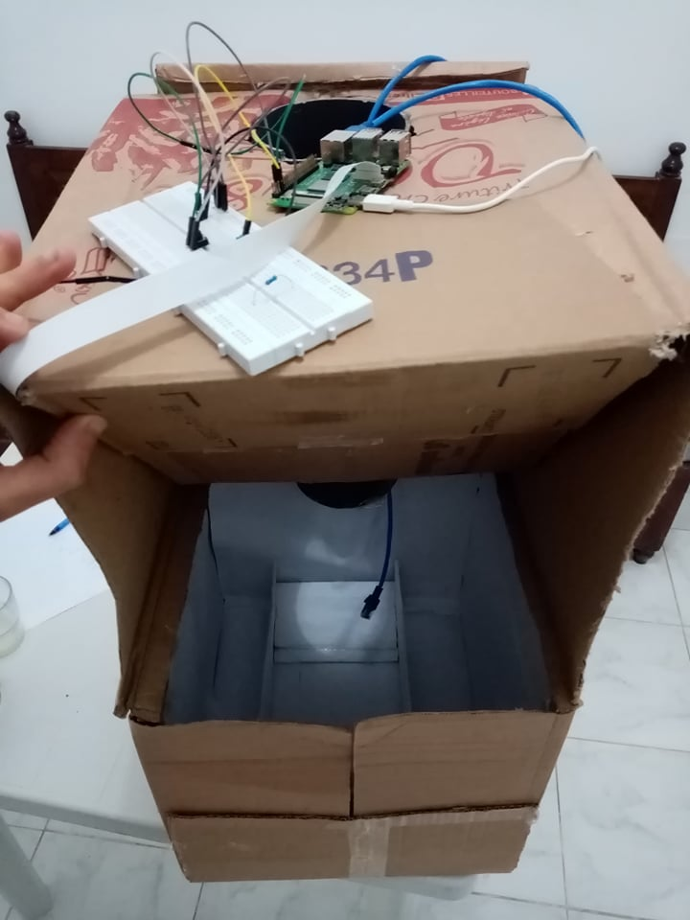
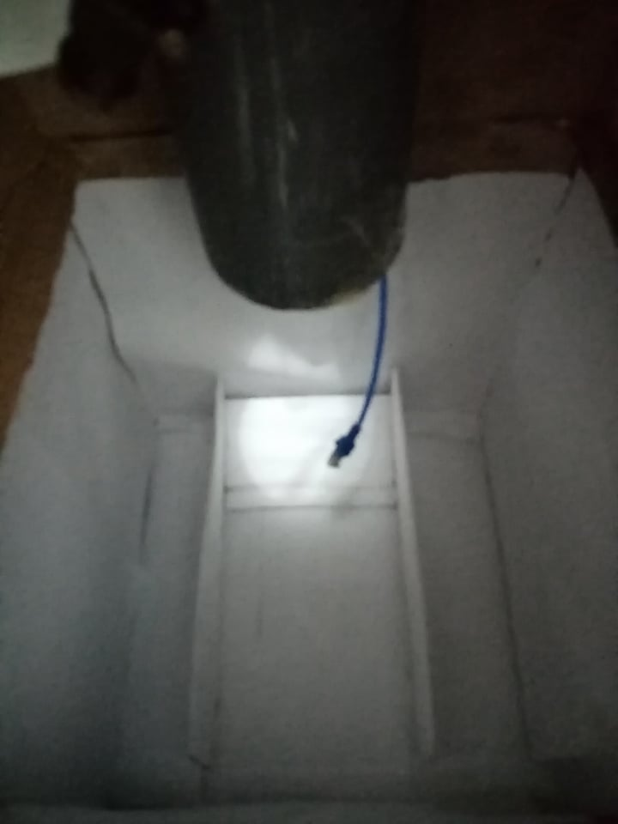
Internal Data [2/3]
(Prototype 0 of our RVM)
12

Slide 13
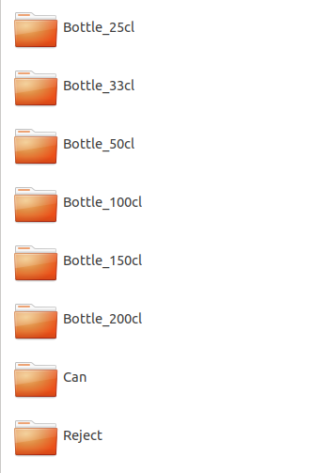
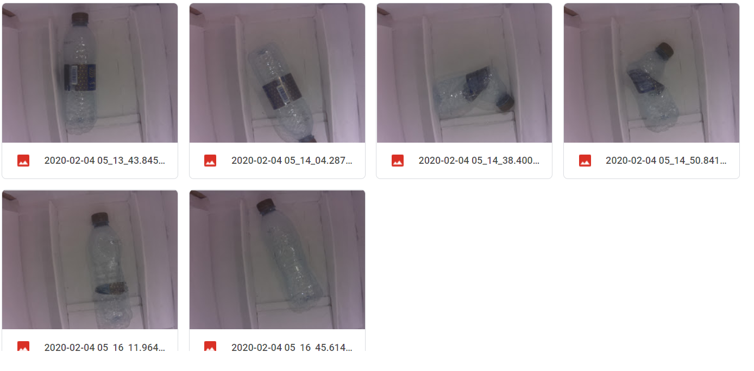
Internal Data [3/3]
13

Slide 14
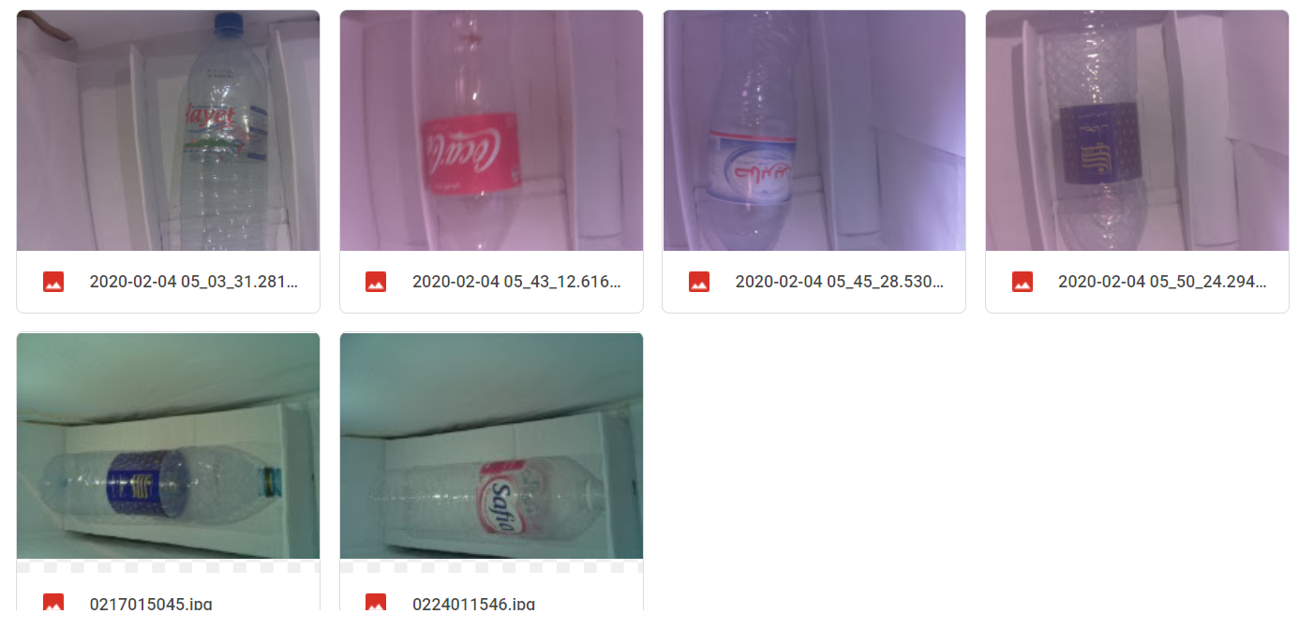
Internal Data [3/3]
13

Slide 15
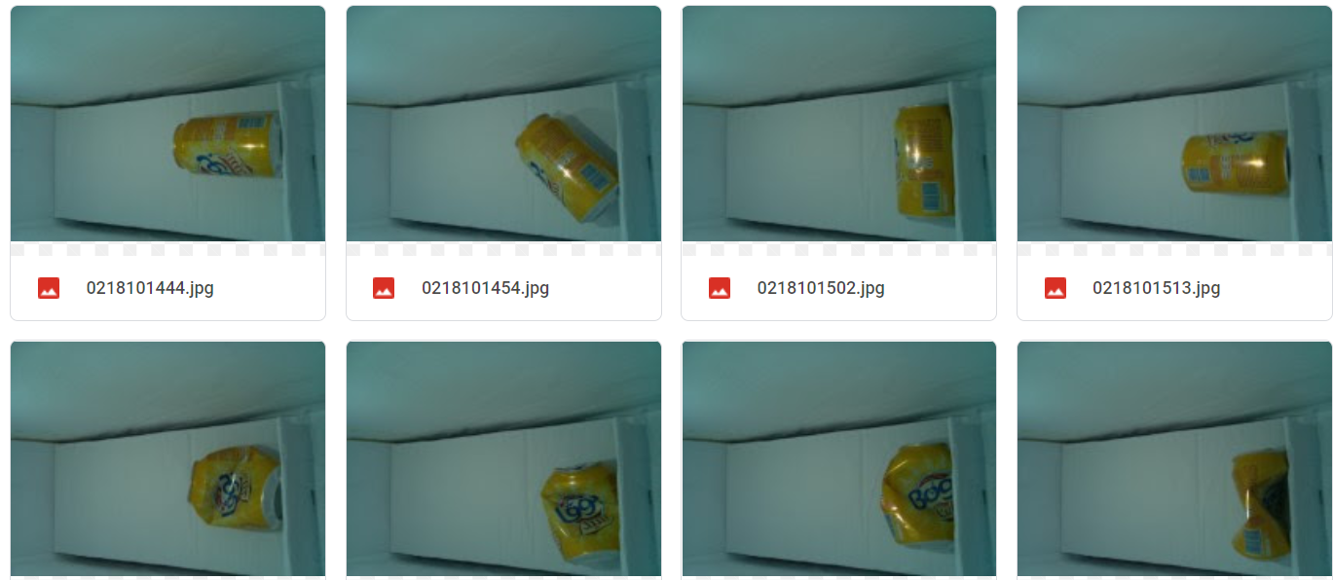
Internal Data [3/3]
13

Slide 16
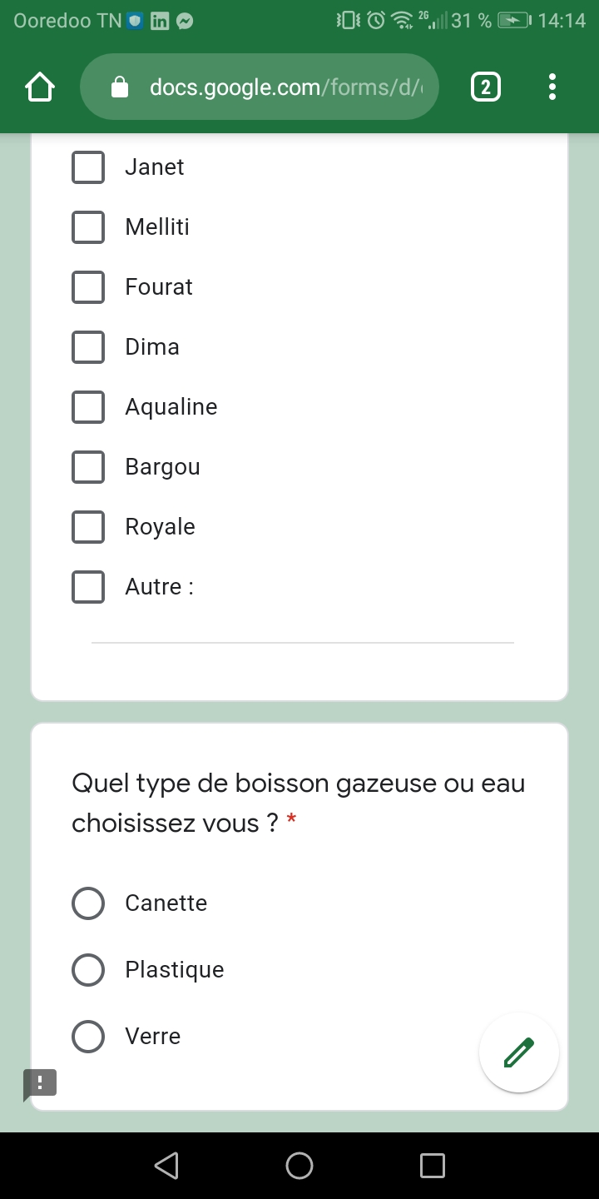
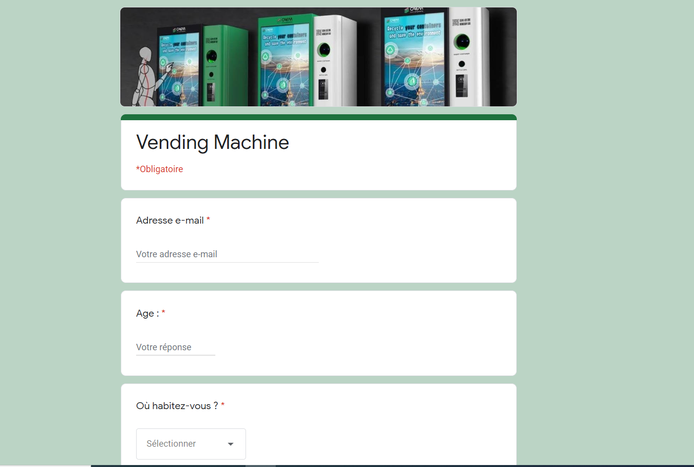
External Data [1/5]
(Source: Google Form)
Where the client want to see the
Vending machine ?
( supermarket / school / companies … )
The types of water they choose
The favorite water/soft drink
of the client
The Profession
The Gender
The localization
14

Slide 17
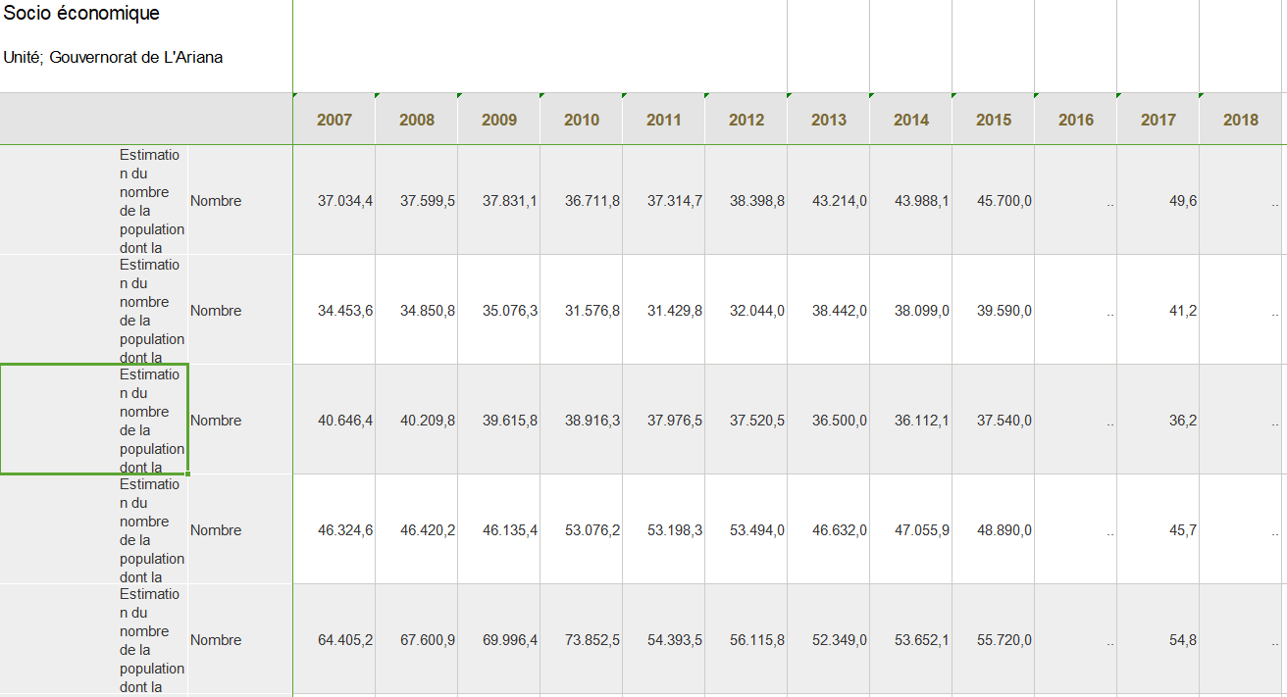
External Data [2/5]
(Source: National institute of statistics)
Estimate the population in
Tunisian region
15

Slide 18
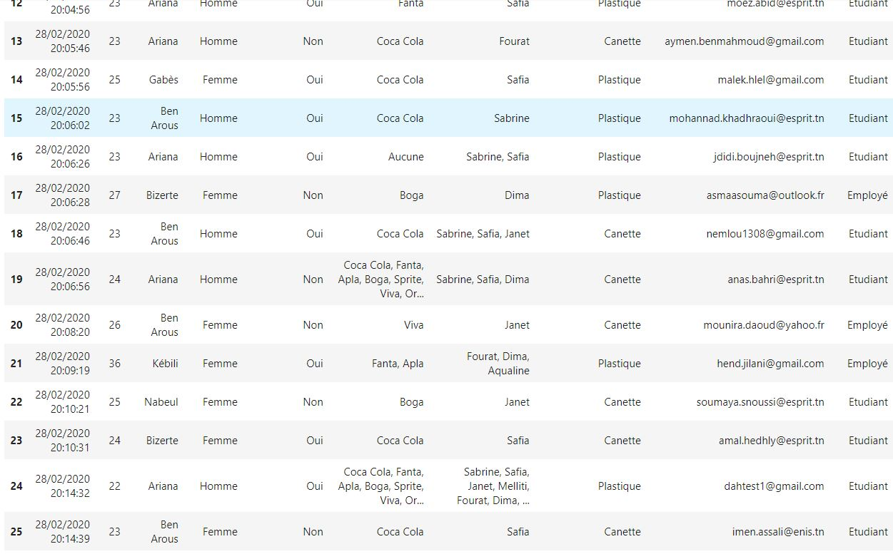
External Data [3/5]
(The DATA Set)
16

Slide 19
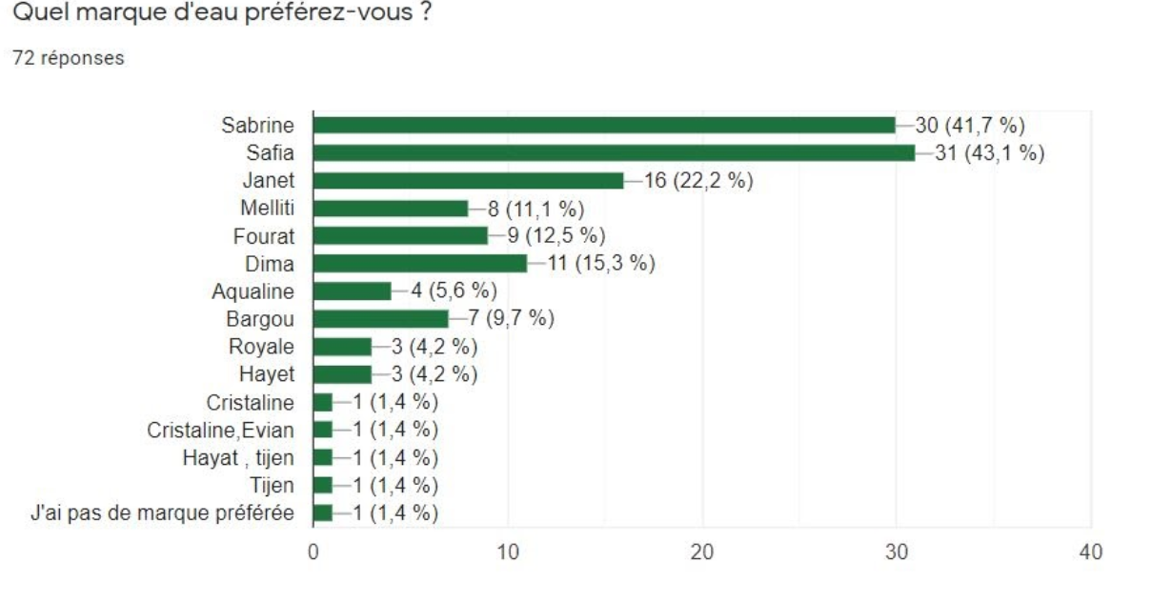
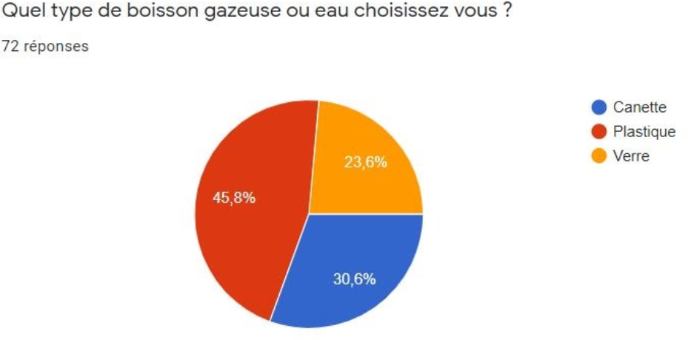
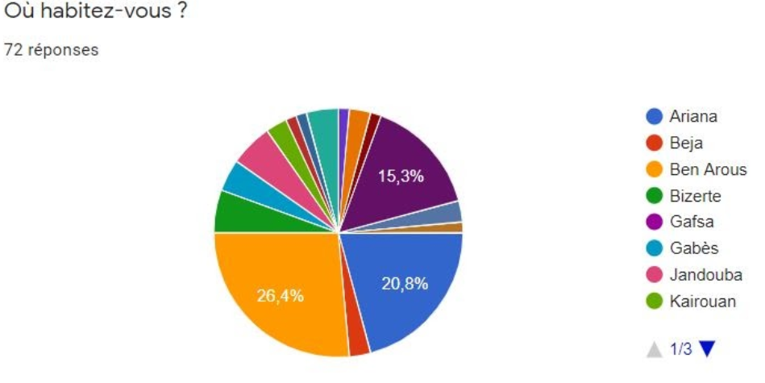
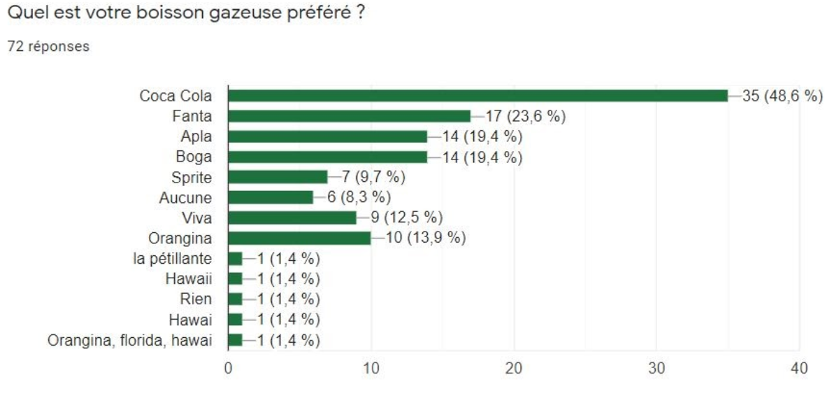
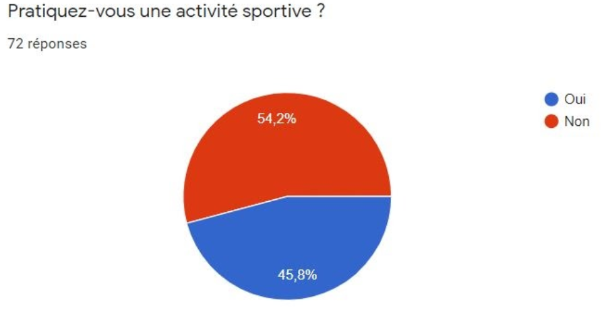
External Data [4/5]
17

Slide 20
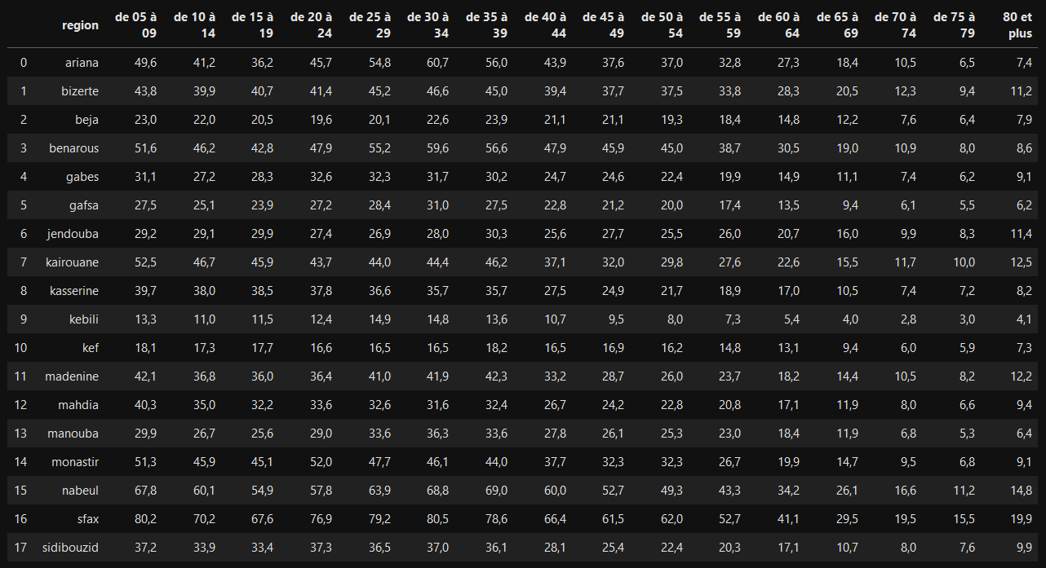
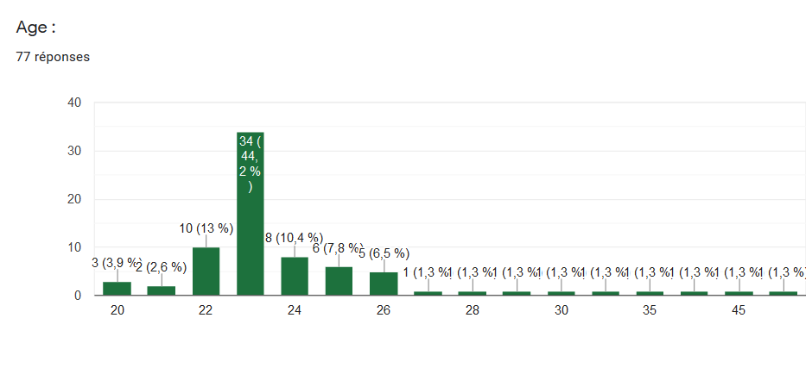
External Data Preparation [5/5]
17

Slide 21
Modeling
19
Notes:
Oddo bhf main goal is to be connected to their customers and able to provide them with the best financial decisions and that by managing its data and incorporate it into its business and professional practices. Our main mission in this project is to help Oddo make those decisions by presenting prediction values for its customers by analyzing and interpreting the provided data in order to help it reach better decisions.

Slide 22
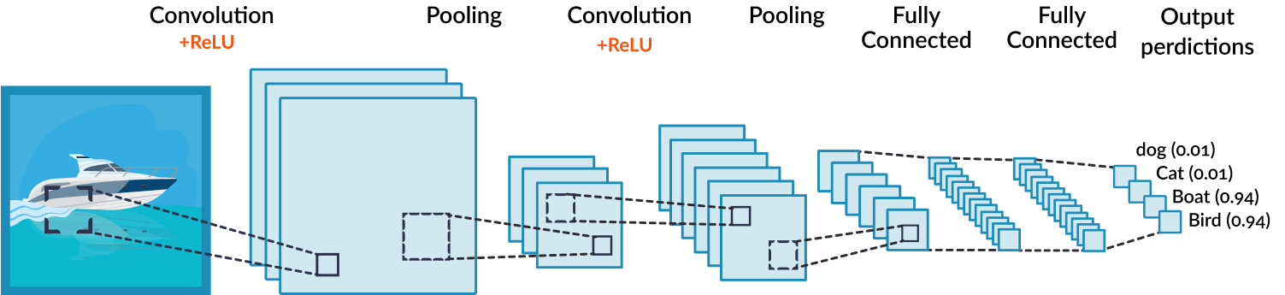
Modeling [1/6]
~How a CNN works~
20

Slide 23
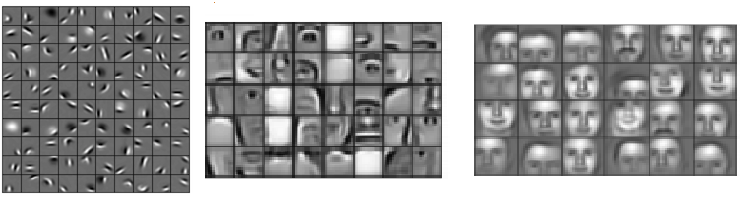
Modeling [2/6]
~How a CNN works~
21

Slide 24
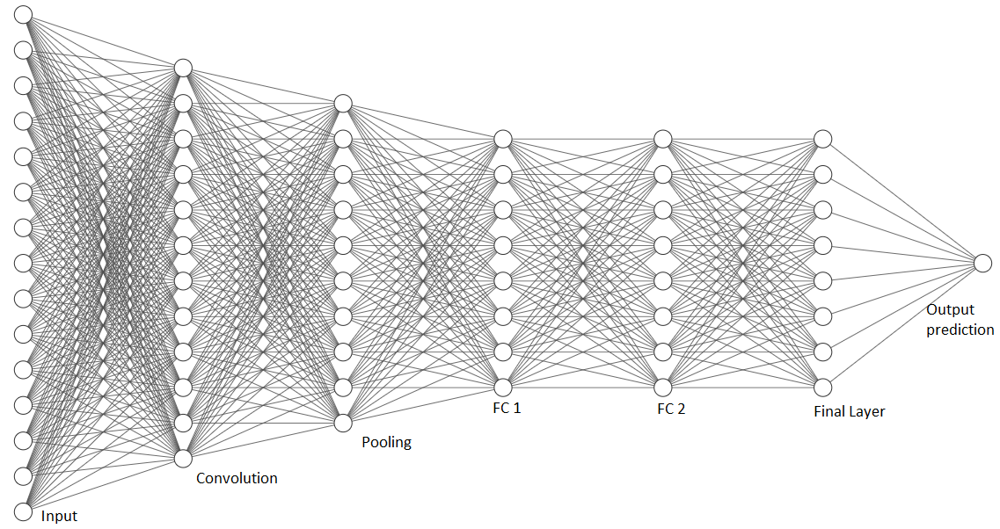
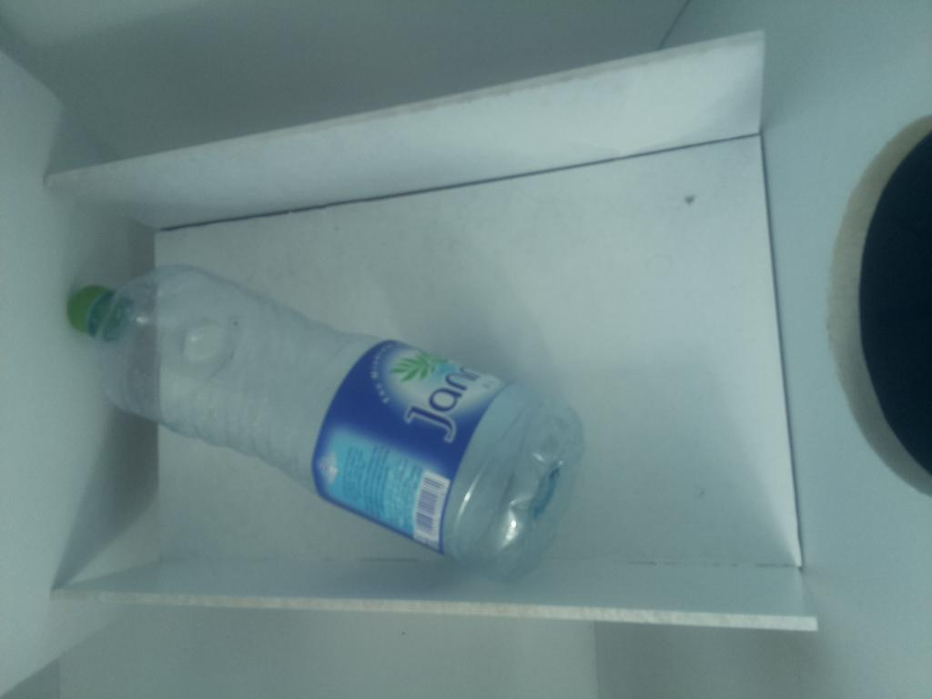
Modeling [3/6]
2L plastic bottle
2h43mn : 47% Accuracy
22

Slide 25
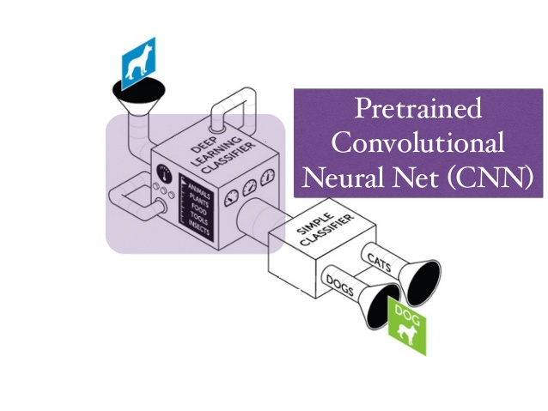
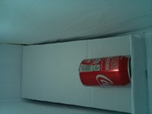
Modeling [4/6]
~ Pretrained CNN : ~
Resenet18
Resnet101
Alexnet
Can
23

Slide 26
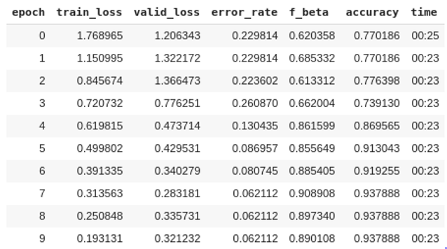
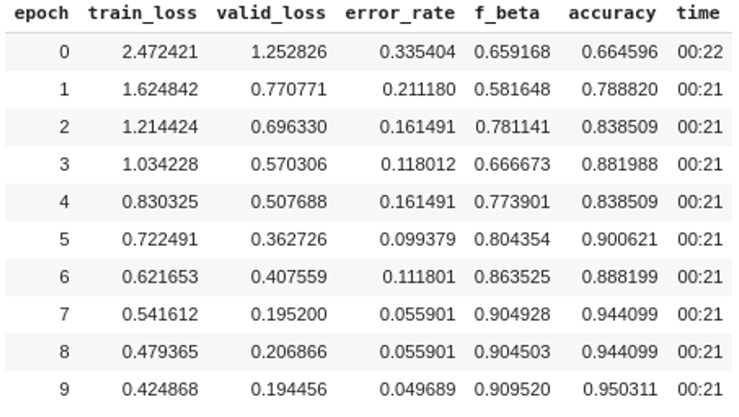
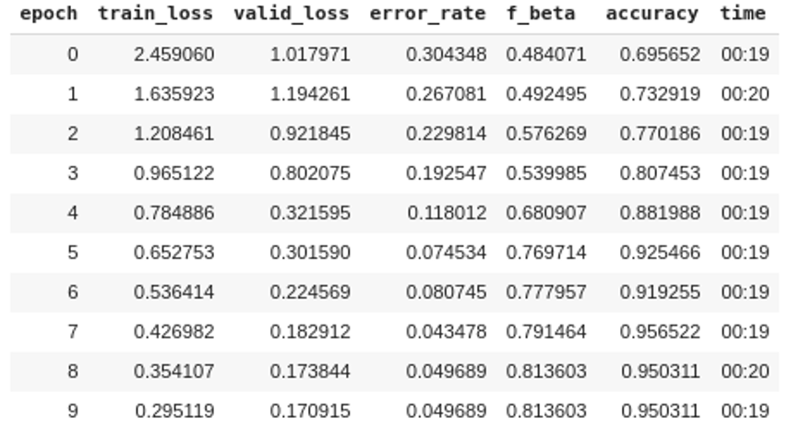
Modeling [5/6]
Resnet101
Alexnet
Resnet18
24

Slide 27
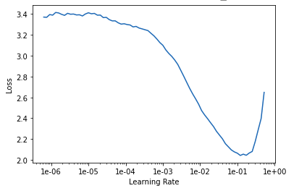
Modeling [6/6]
~ Our choice : Resnet18 ~
Learning rate : 0.1
Algorithm : SGD
N° iterations : 10
Training time : 3:30 with an accuracy of 95.56522%
25

Slide 28
Deployment
26
Notes:
Oddo bhf main goal is to be connected to their customers and able to provide them with the best financial decisions and that by managing its data and incorporate it into its business and professional practices. Our main mission in this project is to help Oddo make those decisions by presenting prediction values for its customers by analyzing and interpreting the provided data in order to help it reach better decisions.

Slide 29
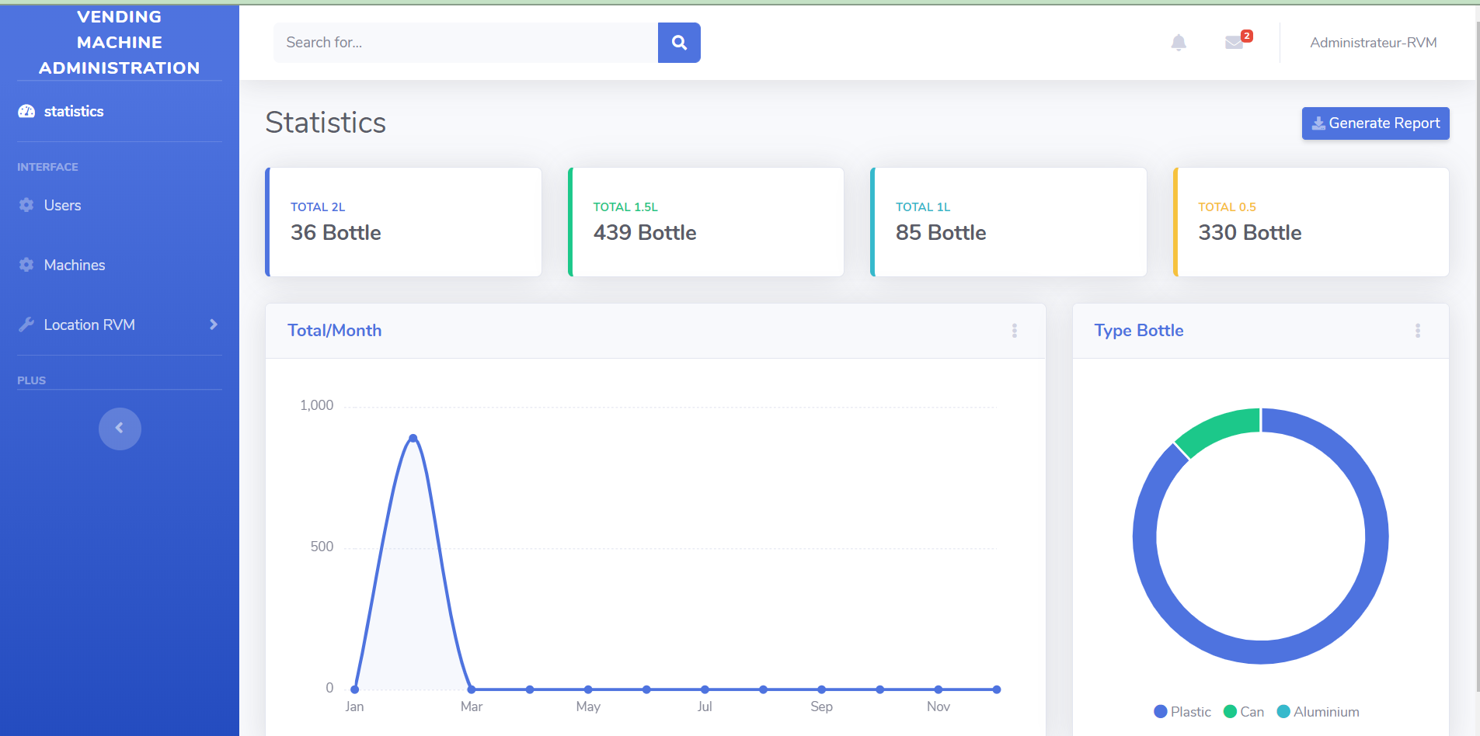
Deployment [1/8]
~Admin dashboard~
Total of bottles putted classified by type
Total amount of bottles per month
Most putted type of bottle
28

Slide 30
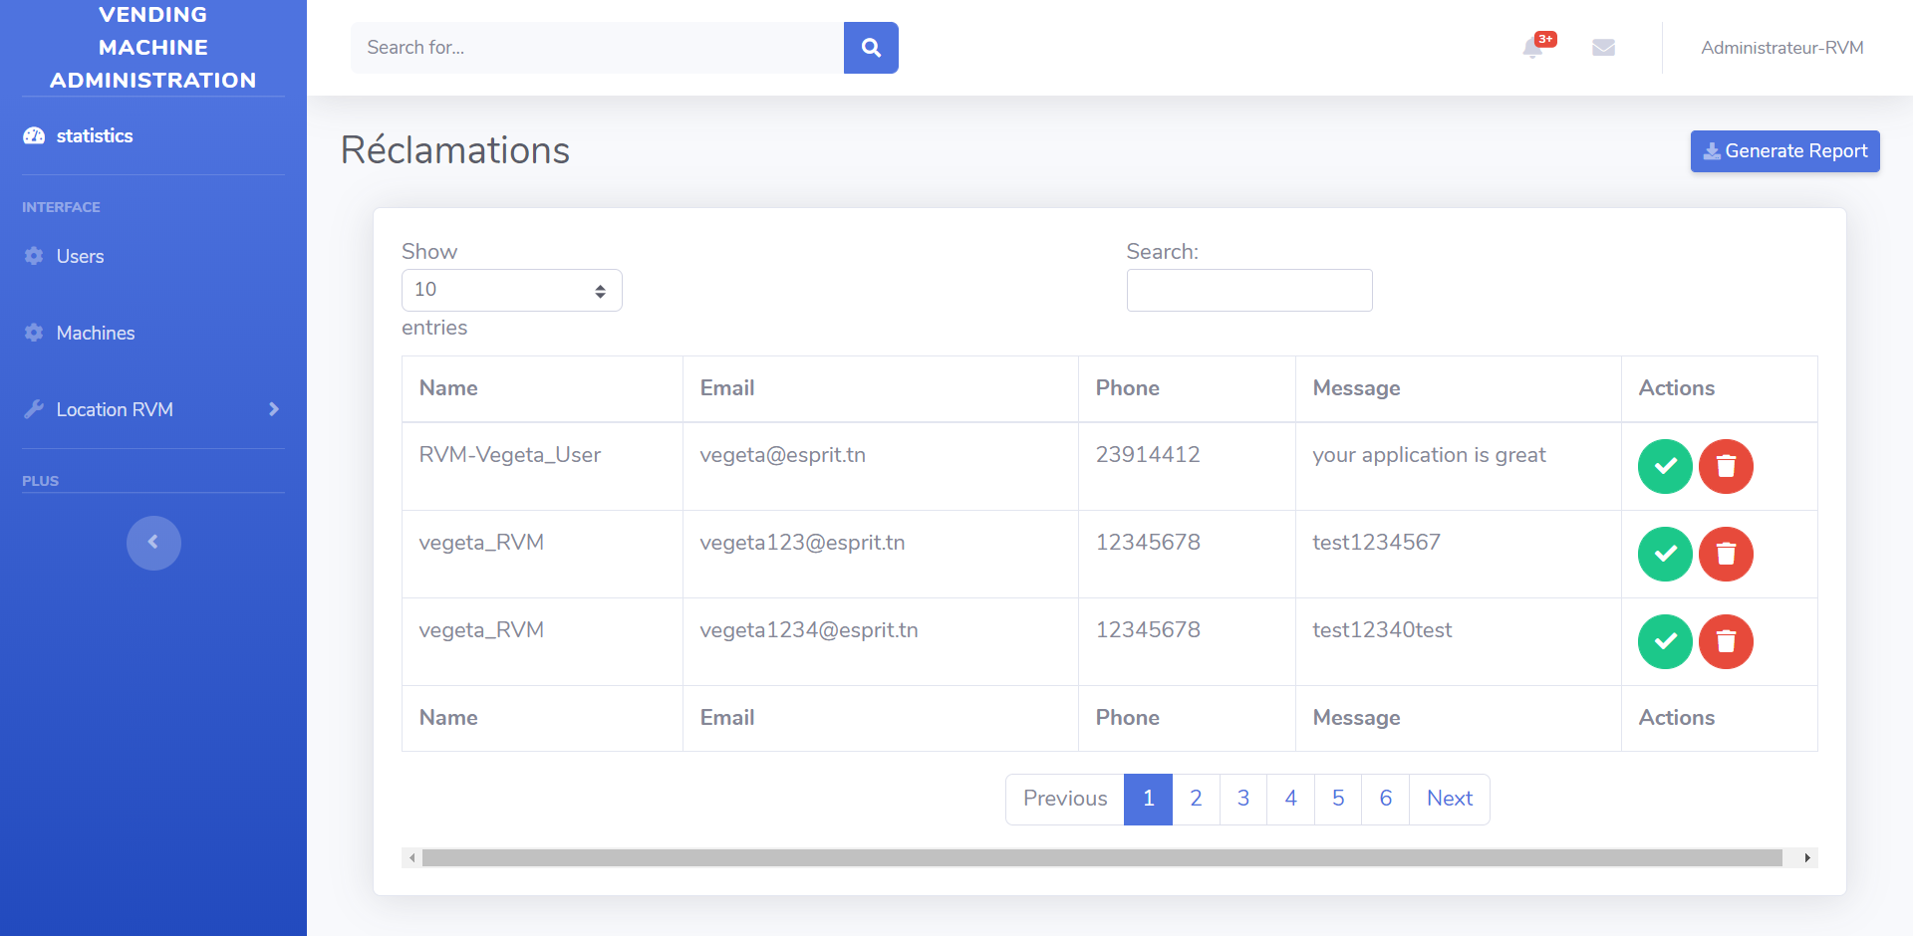
Deployment [2/8]
~Admin dashboard~
28

Slide 31
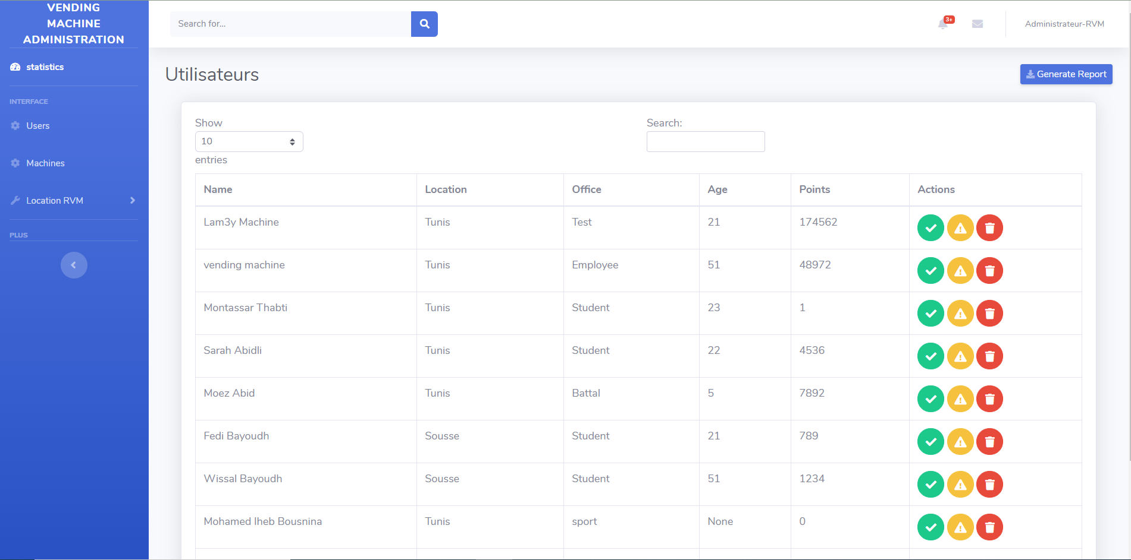
Deployment [3/8]
~Admin dashboard~
The Location
The Profession
Their Points
29

Slide 32
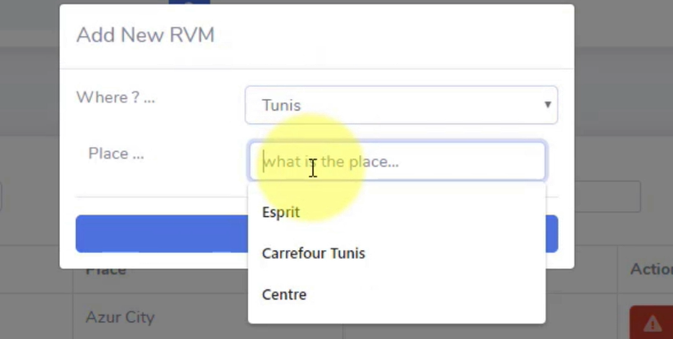
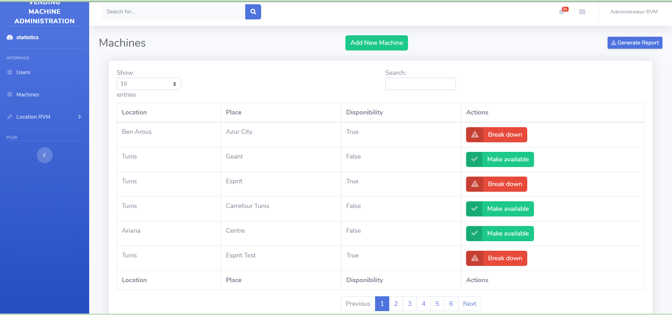
Deployment [4/8]
~Admin dashboard~
30

Slide 33
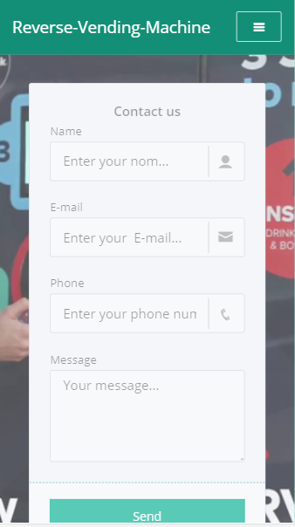
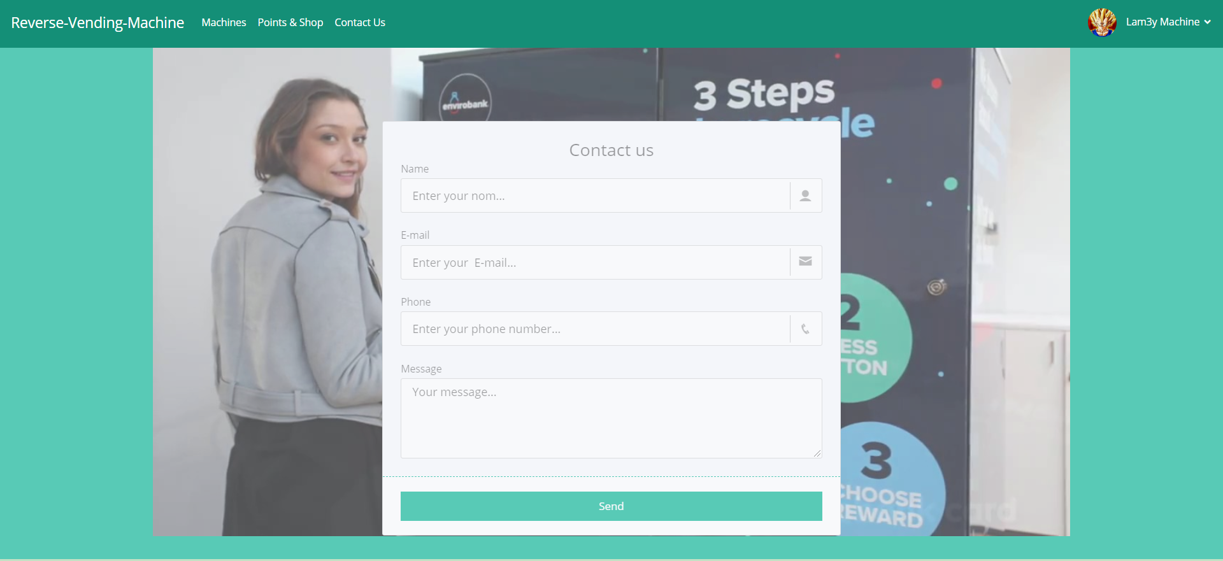
Deployment [5/8]
~Mobile and desktop access~
31

Slide 34
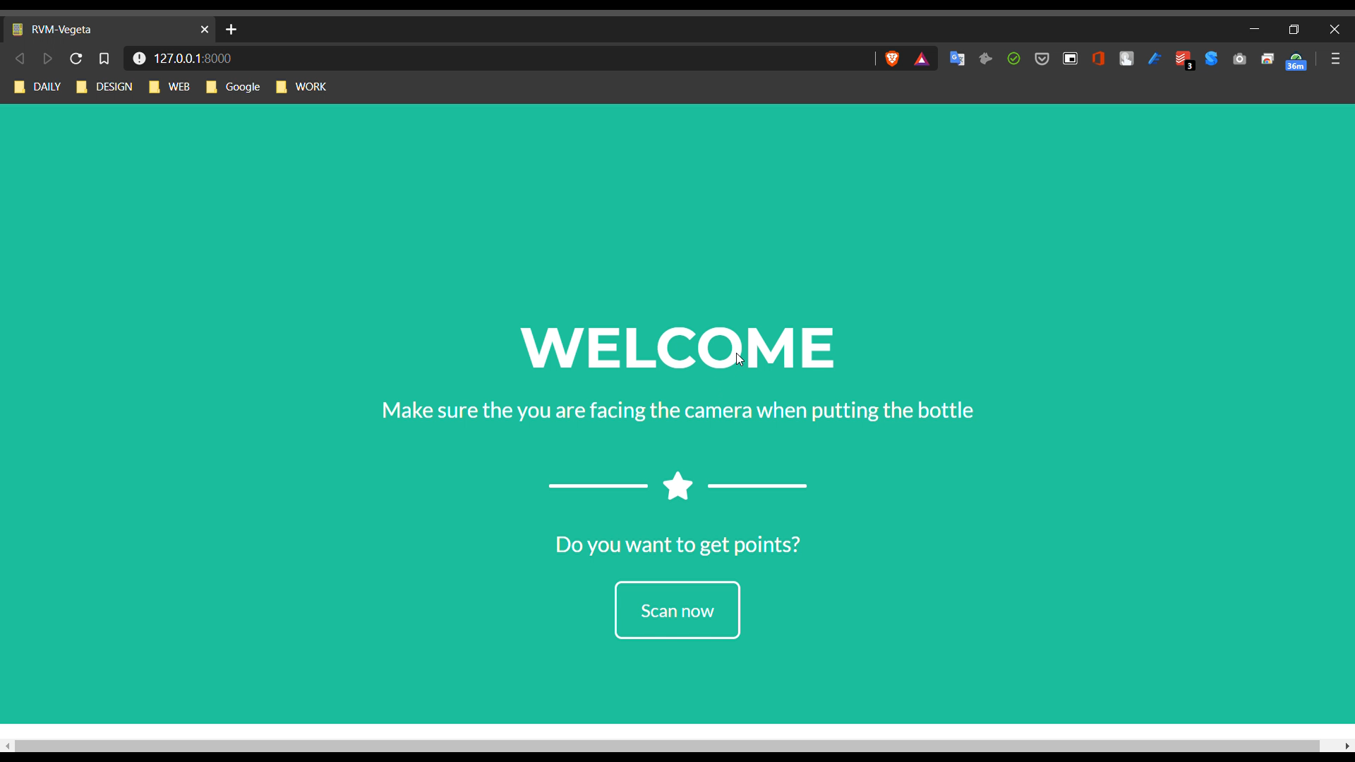
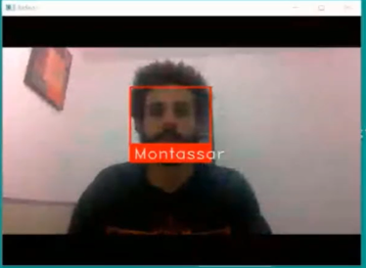
Deployment [6/8]
~Facial recognition system~
32

Slide 35
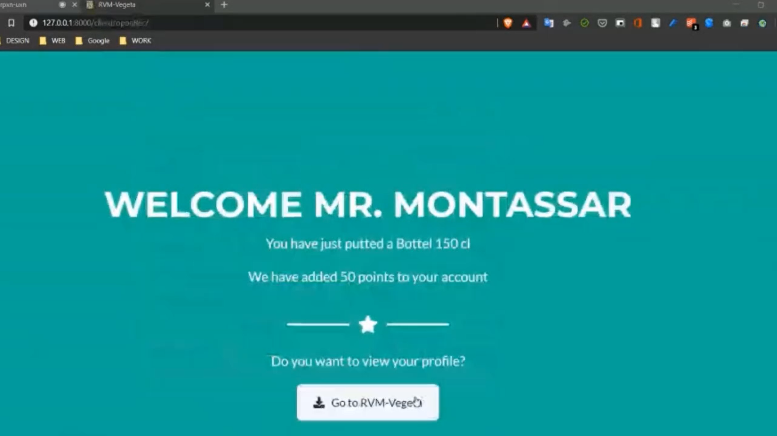
Deployment [6/8]
~Facial recognition system~
32

Slide 36
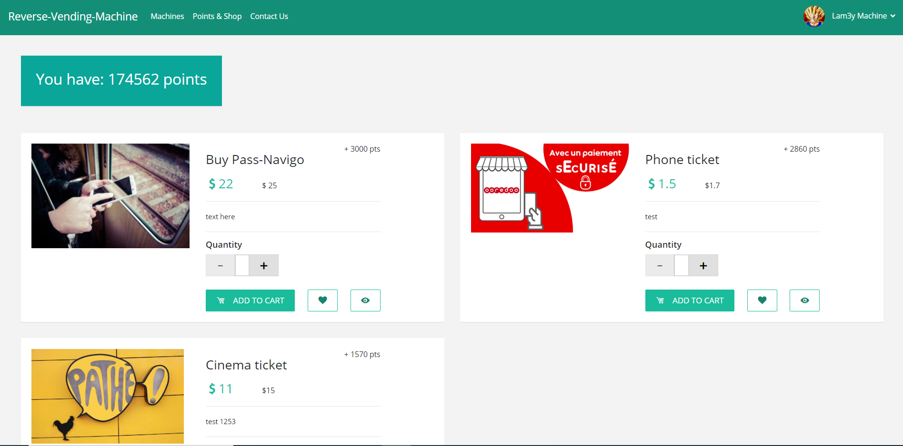
Deployment [7/8]
~User Profile(Shop)~
33

Slide 37
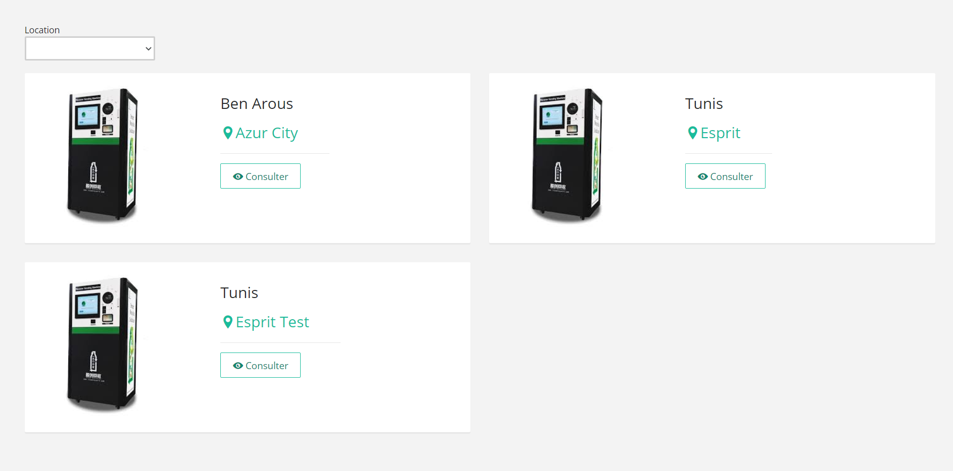
Deployment [8/8]
~User Profile(RVM Location)~
34

Slide 38






Tools & Technologies
Raspberry pi 4
Anaconda
Jupyter
Google Colab
Python
Django
35

Slide 39
Conclusion
& Perspectives
36
Notes:
Oddo bhf main goal is to be connected to their customers and able to provide them with the best financial decisions and that by managing its data and incorporate it into its business and professional practices. Our main mission in this project is to help Oddo make those decisions by presenting prediction values for its customers by analyzing and interpreting the provided data in order to help it reach better decisions.

Slide 40

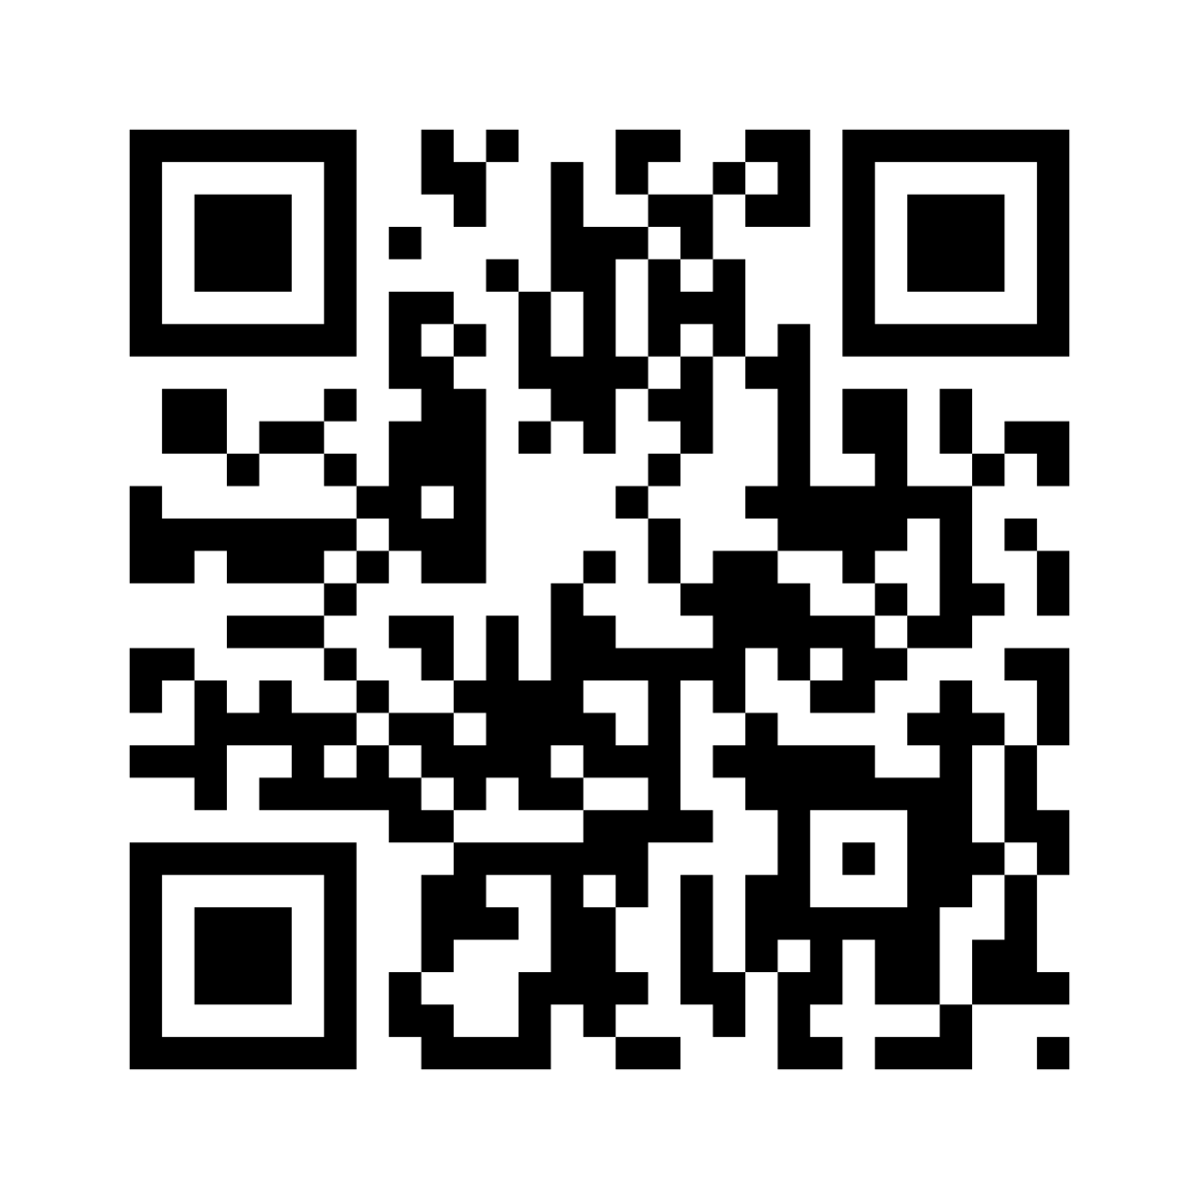
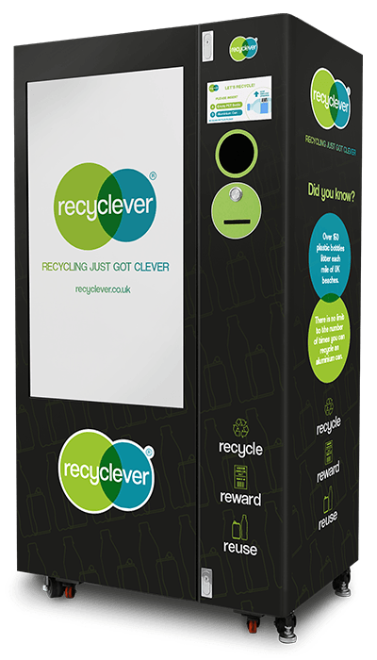
Conclusion & Perspectives
Internationalization
Login with QR Code
Advanced prototype with Solidworks
37

Slide 41
Thank you for your attention
Questions
Critics
Suggestions

